Slide 1
BBC Transport Hackday: West Midlands – transport challenges and opportunities 28 June 2018

Slide 2

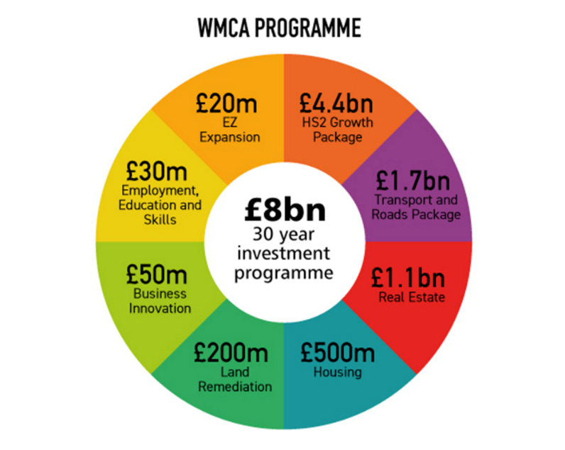
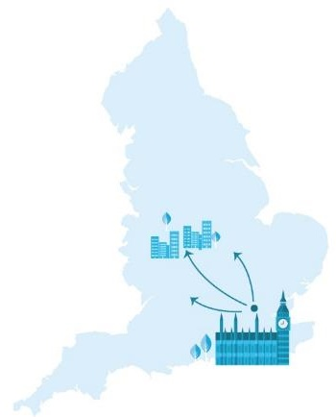






West Midlands Combined Authority
Created 2016
New Mayor, Andy Street
Current Population
Constituent authorities: 2.86m
Constituent & non constituent authorities: 4.58m
…second only to London

Slide 3
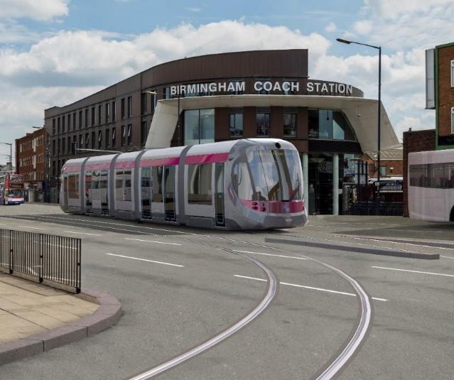
Transport for West Midlands
Transport arm of the WMCA / covers WMCA Constituent Area – supports, co-ordinates
Also promotes Strategic Transport Interventions to deliver on skills, housing, regeneration
Works closely with WMCA’s Non-Constituent Authorities and Local Enterprise Partnerships
Also works with bodies such as West Midlands Rail and Midlands Connect
Mission statement:
“Invests to improve the regional transport system, working towards delivering an integrated system, which supports the positive change in lives of millions of people”

Slide 4



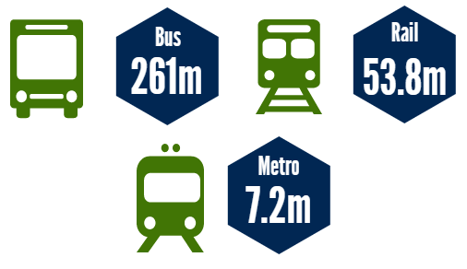



Our network…
Patronage Figures (2016/17)
Our modern devolved railway has over 70 stations and is at the centre of the national network
27m journeys were made using the Swift Card in 2016/17, making the it the largest smart card system outside of London
We manage 38 rail station car parks with 8,319 spaces
We own & operate Midland Metro which covers 21km/26 stops and are expanding the network by approx’ 34km
We fund subsidised buses to cover socially necessary services that are not provided on a commercial basis
We keep traffic flowing on some of the busiest roads by managing a 605km Key Route Network

Slide 5


So our time is now…opportunities
Birmingham youngest major city in Europe
Region growing 450K people in next 20 years
Most ethnically diverse outside London
More FDI jobs than anywhere outside London
45 minutes to London by 2026
20,000 digital and creative companies
Exports up 16% in the last 12 months
2 million square feet of prime office space under development

Slide 6
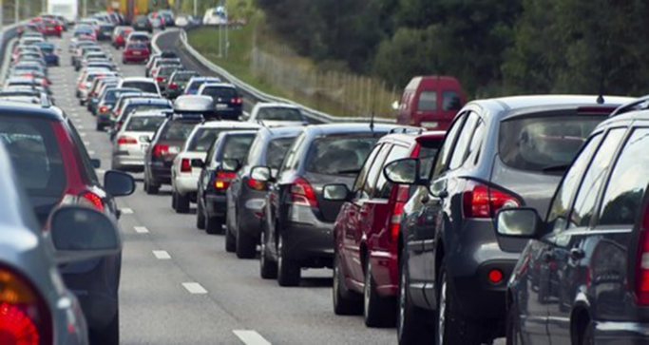
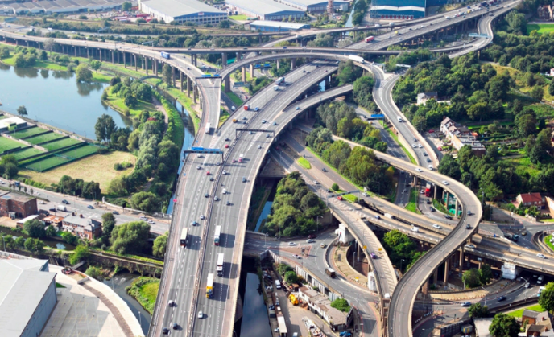
But transport challenges too
Congestion
Levels have increased over the last 5 years
Between 2006 and 2016, traffic on major roads in the West Midlands increased by 5.4%
Birmingham Congestion - 36 peak hours in 2017 (9% of driving time) (INRIX)
Economic impacts
Congestion in Birmingham cost £990 per driver, and £307m for the whole city in 2016 with 34 peak hours spent in congestion (INRIX)
Air quality impacts
1500 premature deaths due to air pollution each year
Need for a Clean Air Zone for Birmingham City Centre and actions in other areas to poor air quality
negative effects such on productivity, and business costs

Slide 7
And structural issues
Population forecast to grow by 444,000 people by 2035
215,000 new homes needed by 2030
150,000 total businesses by 2030
£3.4bn public spending gap
£16bn productivity gap
Major challenges – but we are ambitious in driving change, to benefit our people and area
Economy
Transport
Housing
Notes:
Understanding what changes are coming, and recognising where a collaborative approach can benefit the most.
Improved transport access across the region will help connect homes with education, employment, healthcare and recreation.
With more people connected to more modes of transport, it will help encourage a modal shift away from reliance on cars, ultimately making communities safer, cleaner and with less air pollution.
We can concentrate on making communities for communities rather than for cars.
?

Slide 8
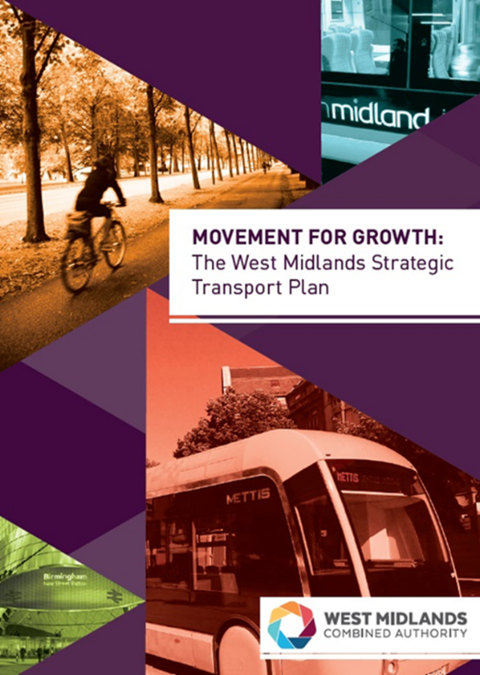
The plan – Movement for Growth
High-level adopted WMCA transport strategy to tackle challenges and deliver improvements over twenty year period
Investing in:
National and Regional Tier
Metropolitan Tier: Rail and Rapid Transit Network, Key Route Network, Strategic Cycle Network
Local Tier
Smart Tier
Informed Mayor’s Renewal Plan priorities
With supporting 2026 (HS2) Delivery Plan

Slide 9
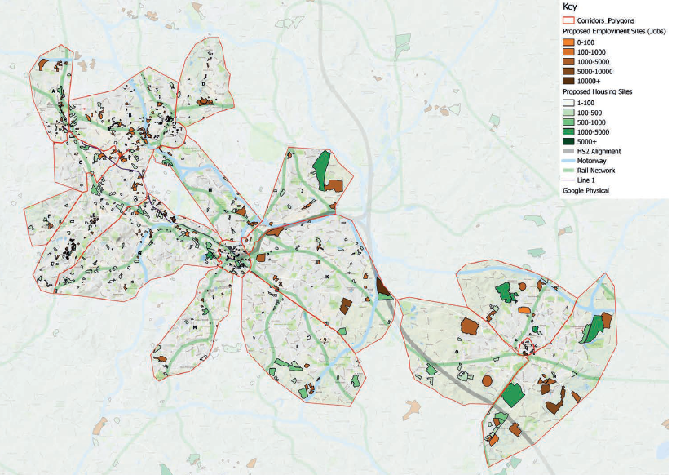
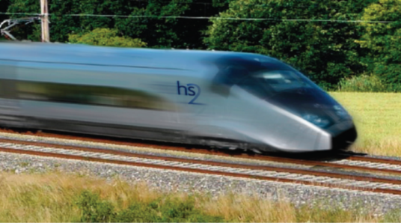
2026 Delivery Plan for Transport
Transport Delivery Corridors (with major land use sites)
HS2 the key - £2bn economic benefits – if we:
‘Plug-in’ two HS2 stations (airport an city centre) to wider transport network
Align transport with land use and housing in key corridors
Link transport with homes, jobs and places
As sound basis to develop a wider Spatial Investment and Delivery Plan
Notes:
HS2 Connectivity Programme – unlocking further opportunities for infrastructure growth, employment growth and allowing more businesses and people to benefit from this revolutionary era.

Slide 10
Birmingham 2022 Commonwealth Games
A “Public Transport Games”
Demolition of former BCU campus for £370m athletes village in Perry Barr to accommodate 6,500 athletes and officials
New residential quarter
A34 Walsall to Birmingham SPRINT
Investment in rail stations
Active travel & Public Realm
Games legacy - 4,000 new homes and transformational transport improvements
Notes:
Hosting the Commonwealth Games will link into the existing strategy of BCC and TfWM policy.
The Commonwealth Games allows for the prioritisation of certain transport schemes, helping to speed up their development. This transport infrastructure will benefit the area by providing greater transport provision to areas, and unlock areas for housing that may not be suitable before. The SPRINT network and new rail stops will be developed to fit with the public transport theme of the Games.
The Athlete’s Village will be built in Perry Barr, which will be used as flats following the Games.

Slide 11
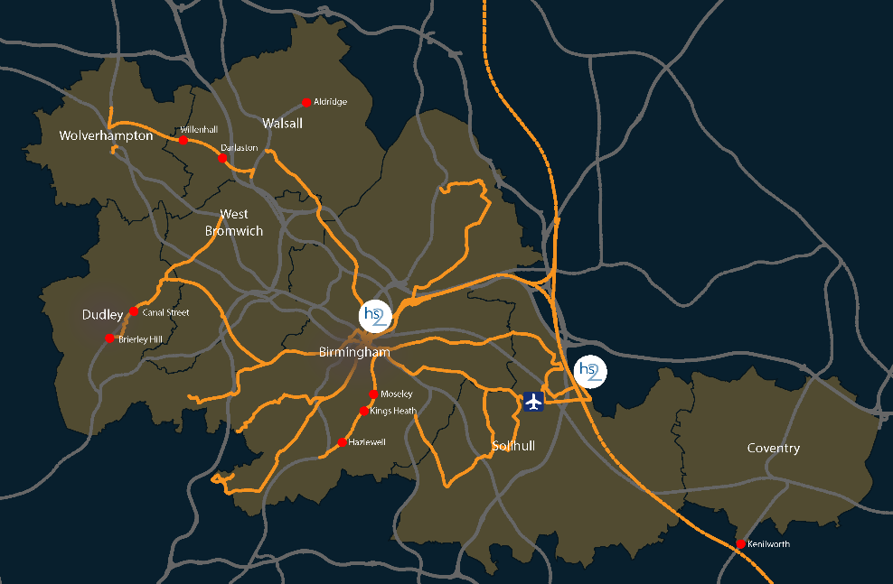
New golden era for trains
70% increase in rail travel over the past 10 years
Biggest station investment programme for a ‘Generation’
New Stations include:
Moseley
Kings Heath
Hazelwell
Willenhall
Darlaston
Brierley Hill
Canal Street
Notes:
New station proposals will increase the convenience of travelling by rail across the region and decrease the need for car usage, especially for journeys to city centres.

Slide 12
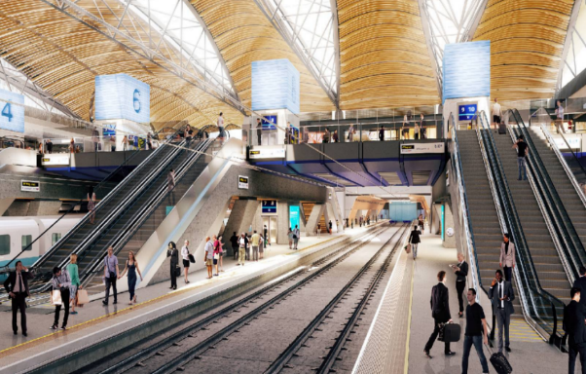
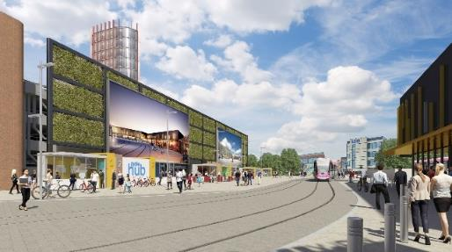
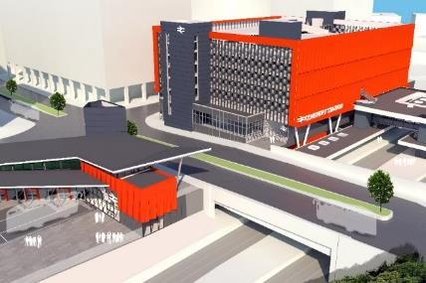
Four new gateway stations

Slide 13
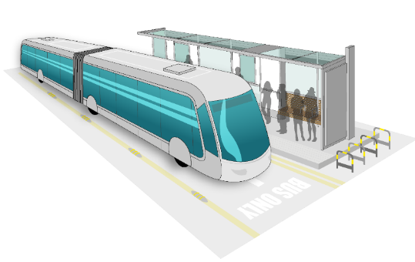
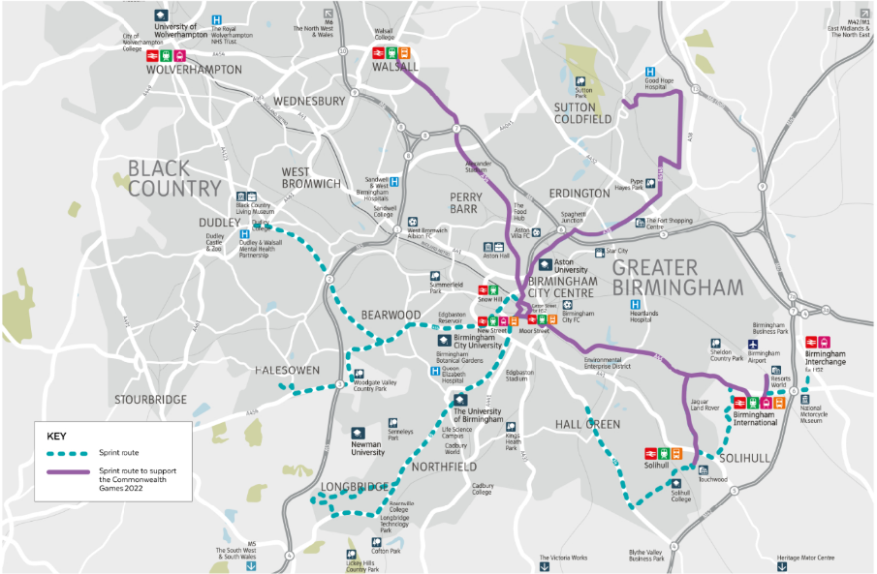
Longest Bus Rapid Transit network in Europe - Sprint
Road-based rapid transit solution
Tram-like quality and experience
More direct routeing with less frequent stops, quicker journey times, high quality vehicles with off board ticketing, multi door boarding and dedicated infrastructure
Notes:
SPRINT is essential to support the Commonwealth Games in 2022, and as a result, three key routes have been given prioritisation to ensure they are ready for the Games. The prioritisation routes provide access to the key Games sites.
This includes: Birmingham to Walsall along the A34- passing the Alexander Stadium and Athlete’s Village at Perry Barr;
Birmingham to Solihull along the A45- passing the Games venues at the NEC site.
It also includes Birmingham to Sutton Coldfield town centre via Tyburn Road. This is a key route which will support the major housing development at Langley of 6,000 homes, and the Peddimore industrial development.
Future routes will go to Halesowen, Dudley and Longbridge.

Slide 14
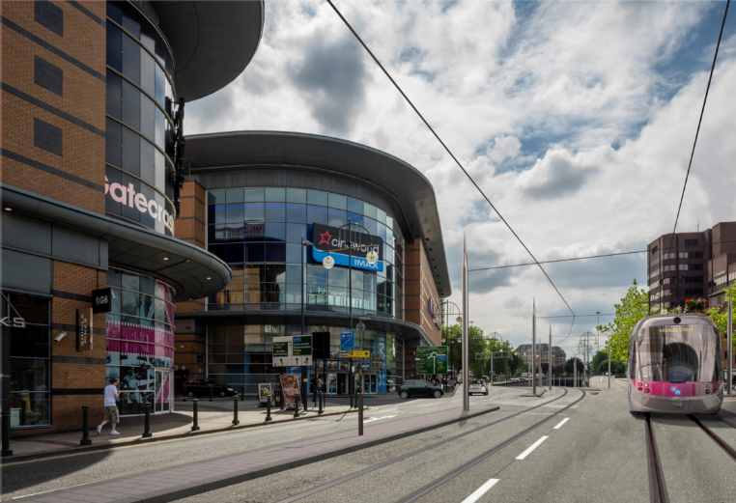
New golden era for Metro
Centenary Square-Edgbaston Extension 2019- 2020/21
Wolverhampton Interchange 2019/20
Eastside 2022/23
Wednesbury to Brierley Hill 2023
East Birmingham to Solihull 2026
Help to unlock housing and development, with higher density around key hubs
50 more trams – from 7 to 30m passengers
A Crossrail for the Midlands

Slide 15
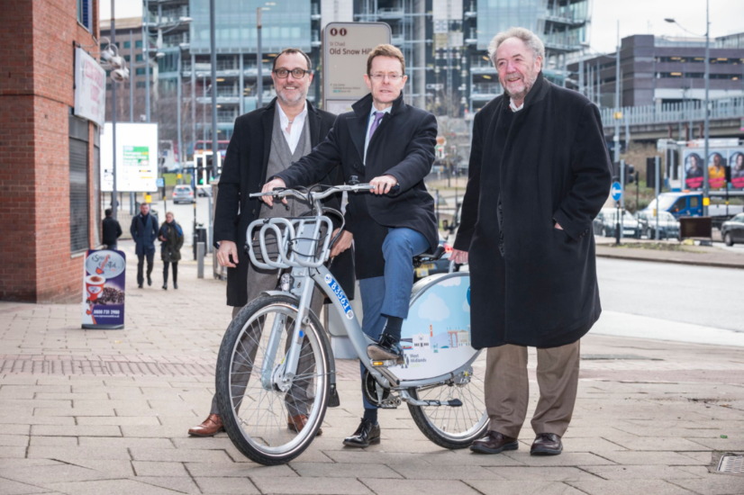
Kickstart walking and cycling
NextBike Bike Hire
Largest docked bike-share scheme outside of London
Docking stations located around key sites of towns and cities
5,000 bikes across Birmingham, Coventry and Wolverhampton
Linked to key destinations, cycle routes and places where work and live
Payment by Swift card – integrated system
Notes:
Bike share scheme – promoting sustainable transport
Swift card users able to use it – widening accessibility
Promoting healthy living, and making cities cleaner and more attractive to be in

Slide 16
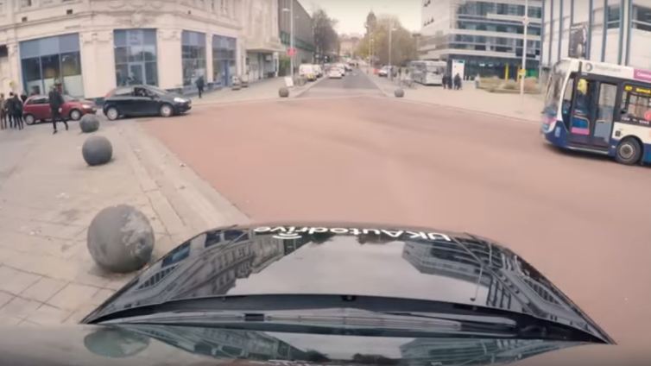
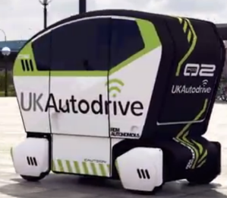
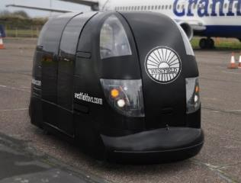
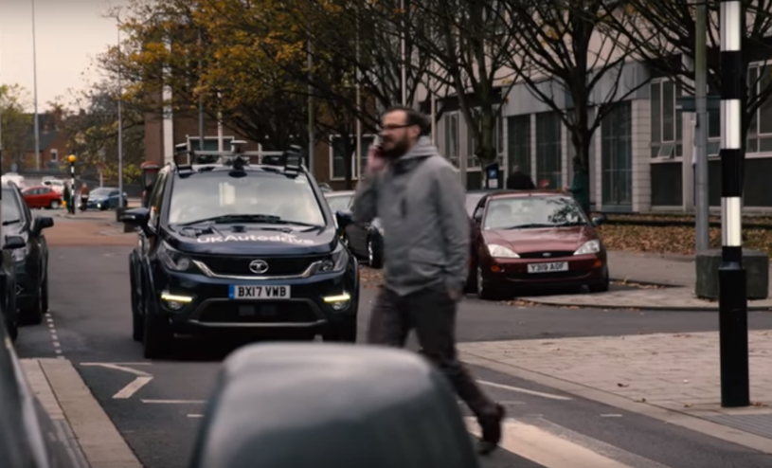
Put region at forefront of global innovation
~30 Projects, >£75m programme, 30+ partners, rolling delivery for next 6 years
UK’s largest urban CAV ‘living lab’- 82km, £23m open in two years
New opportunities – levered benefit
Notes:
TfWM are at the forefront of developing intelligent mobility systems and testing CAVs, to position the West Midlands at the heart of global innovation.
Connecting people, cities and contributing to eliminating barriers/access to transport, health, education etc.

Slide 17
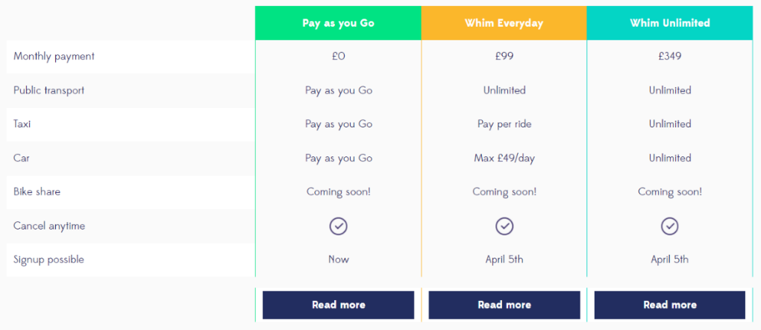
Put region at forefront of global innovation
Whim – first Mobility as a Service (MaaS) trial outside of Helsinki

Slide 18
But can’t do it alone, or all at once
Communicate the scale of the challenge – resilience, air quality
And the range of partners and stakeholders – inclusive growth, all matter
Limits to power and role of private sector – jobs, wealth, transport operations
But in it together – for better not worse
Success breeds success
And take devolution forward – but don’t take for granted

Slide 19
Thank you
Any questions?

